Slide 1



Implementing Transformer with Python & PyTorch
Quang Duong

Slide 3
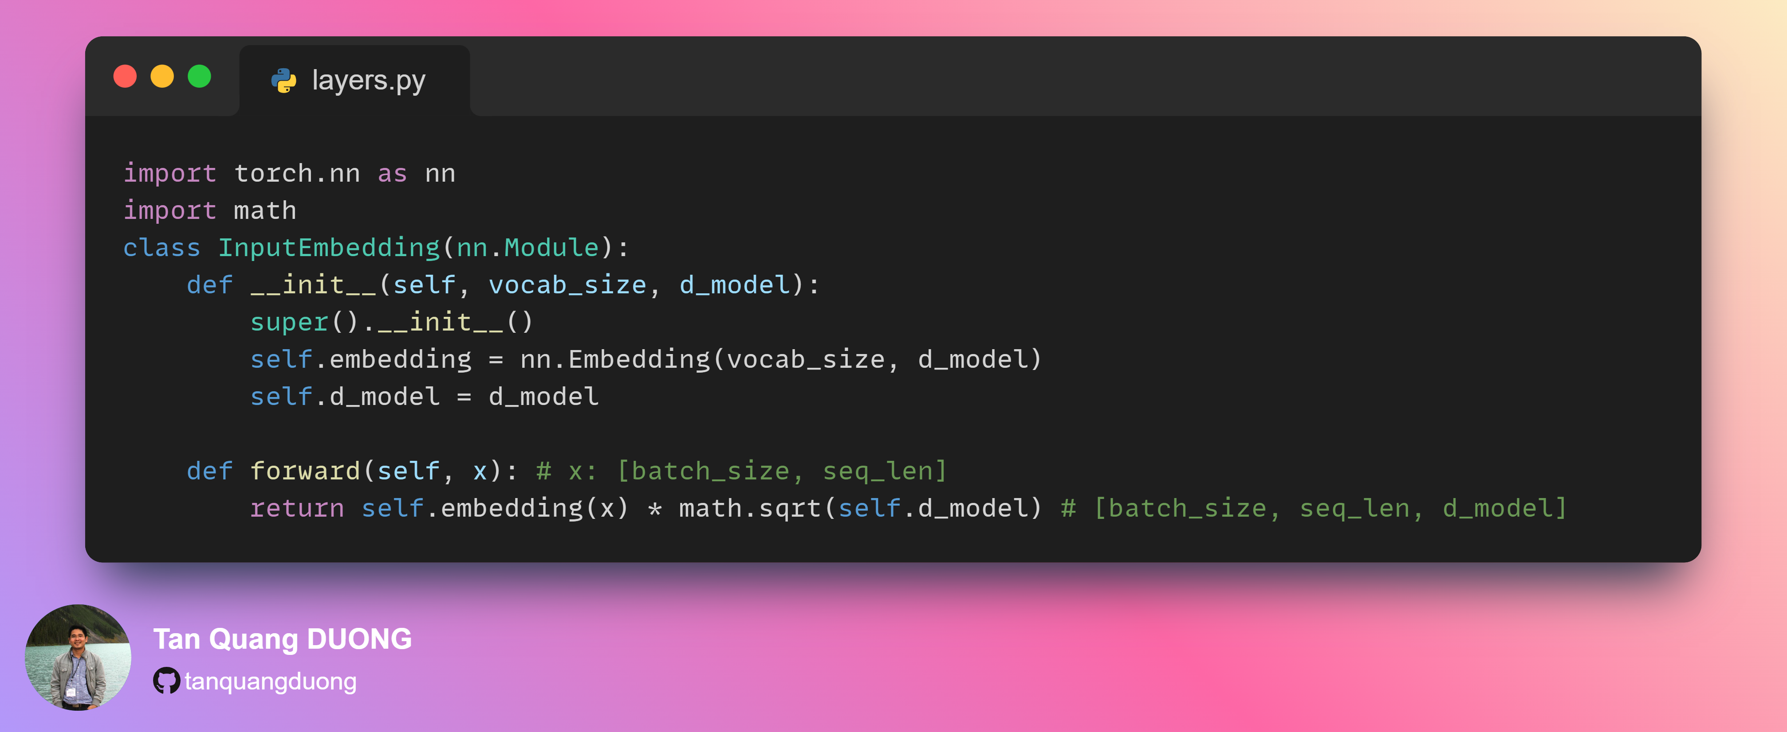
Layers-Input Embedding

Slide 4
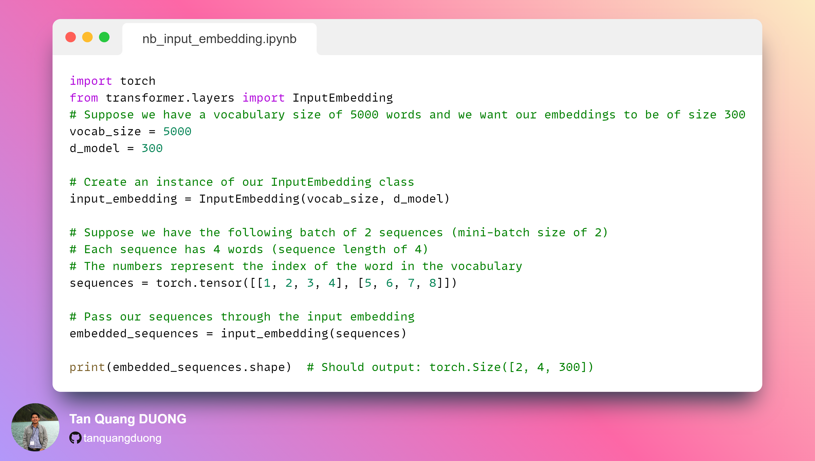
Input Embedding Notebook

